Slide 1
Case 1: DM Dr. Patel
66 year old male
Diagnosis: Non-small cell lung carcinoma with choriocarcinomatous differentiation, staging scans concerning for metastasis to brain, bilateral adrenals, descending colon and lymph nodes; Caris consistent with germ cell tumor (92%)
Other Clinical Information:
Performance Status: Hospice
Hepatic Function: AST 35; ALT 63; ALP 102; T. Bili 0.3; Albumin 2.2; T Protein 5.5
Renal Function: BUN 13; Cr. 0.54
Family History: Mother and father w/ unspecified cancers
Comorbidities: HTN, HLD, COPD
Oncology History:
3/2025: Craniotomy
4/2025: S/p carboplatin + etoposide cycle 1, then pt desired to stop all treatment and opted for home hospice
Molecular Testing:
Specimen Site: Brain; Collected: 3/2025; Panel: Caris; Dated: 4/2025

Slide 2
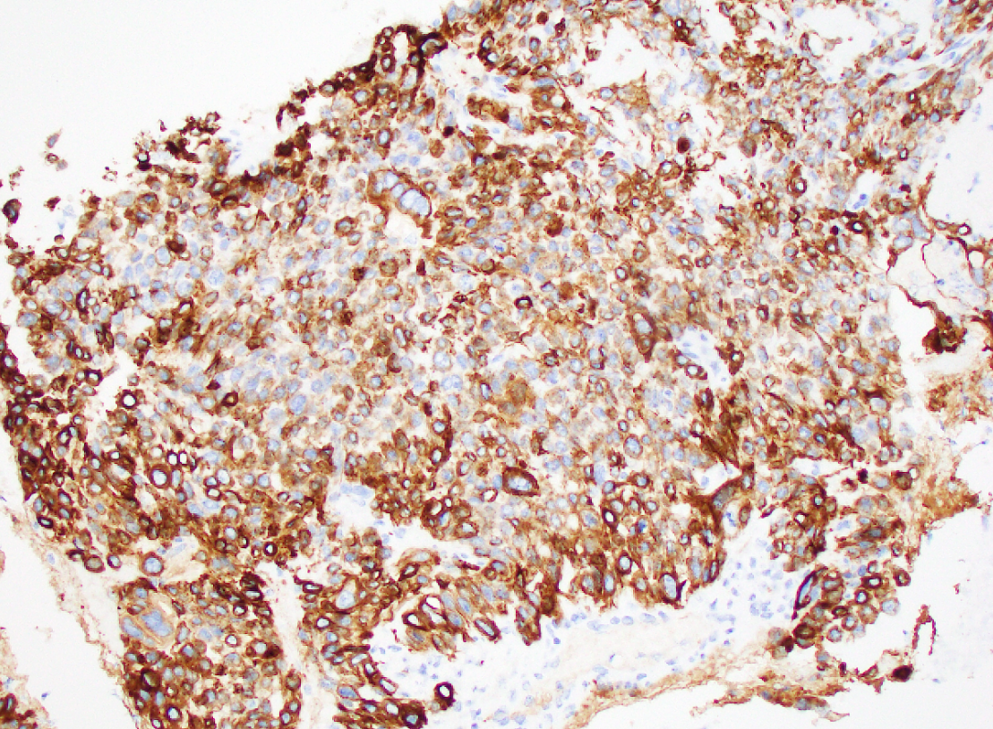
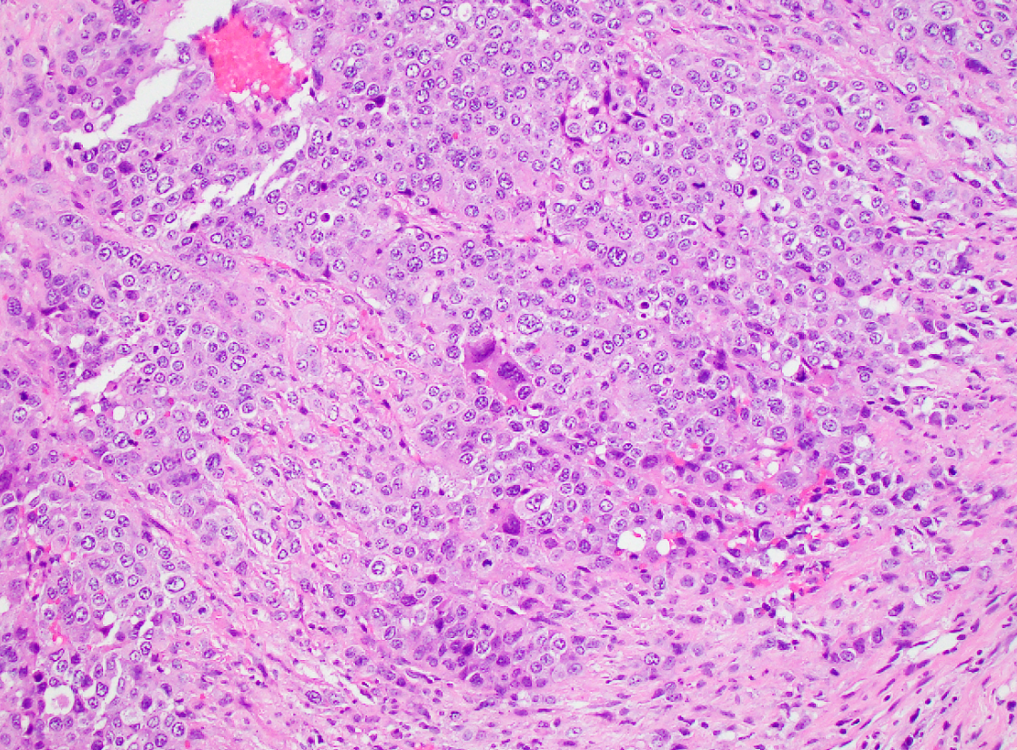
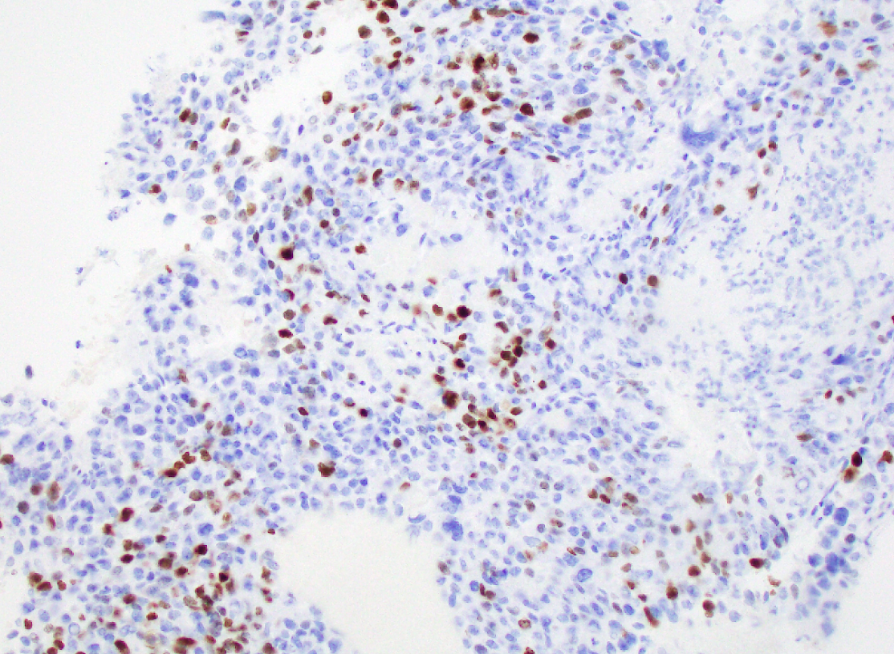
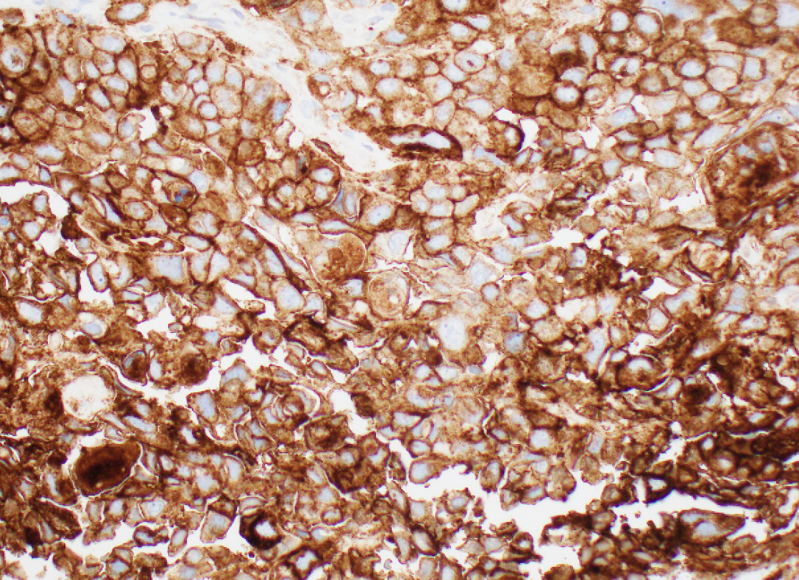
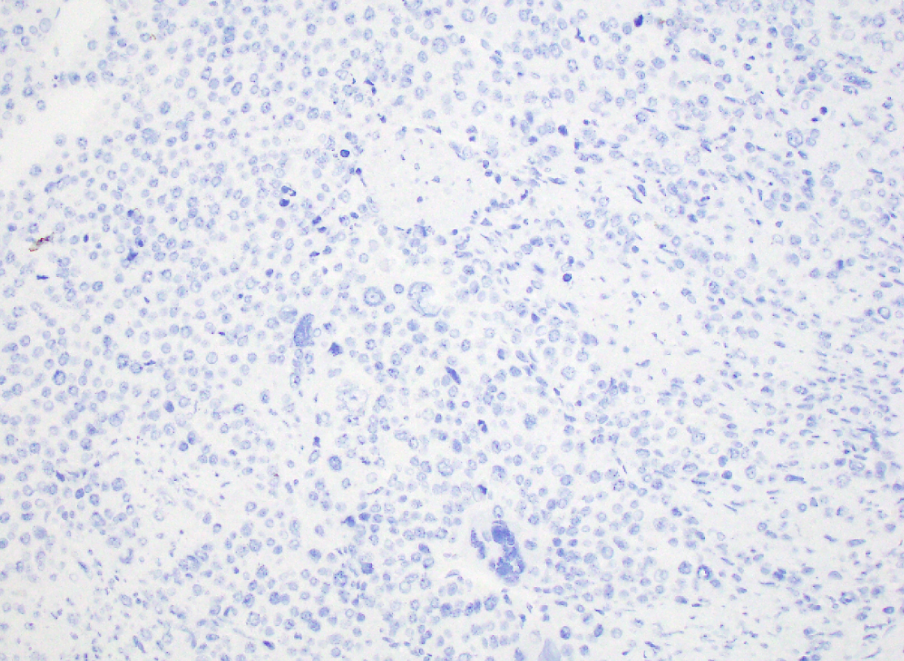
Case 1
CK7
p40
TTF-1
PD-L1: >95%

Slide 3
Case 1
Tobacco-associated DNA damage signature was detected (this is not a germ cell tumor)
SALL4 variably positive (usually strongly positive in cytotrophoblastic cells cells)
Inhibin weakly positive in syncytiotrophoblastic-like cells (usually strongly positive)
Human placental lactogen and HCG detected (mRNA level)
GATA-3 diffuse (usually just in cytotrophoblastic cells)
PD-L1 is usually positive in the syncytiotrophoblastic cells in choriocarcinoma, not strong and diffuse in every cell
GPSai: 92% germ cell (largely mRNA based, COSMIC signatures not utilized); 3% NSCLC
Take-home: Metastatic non-small cell carcinoma with choriocarcinomatous-like differentiation, consistent with a lung primary
Essentially a NSCLC running a primitive trophoblastic-like program (i.e. homeobox genes for placental development could be turned on)
The NOTCH1 and DACH1 dysregulation in this tumor may be affecting developmental pathways

Slide 4
Case 1 Prior: None Caris Current: Carboplatin/Etoposide Dx: NSCLC with choriocarcinomatous differentiation
Alteration | Function | Oncogenic | On-label | Clinical Trial | Off-label (Evidence level) | Allele frequency (%)
HER2 amplification | Receptor tyrosine kinase | IHC 3+ | Trastuzumab deruxtecan | None | None | N/A
BCL2 deleted | Anti-apoptotic protein | Unknown | None | None | None | N/A
DACH1 c.1436-2A>T | Tumor suppressor; transcriptional repressor | Unknown | None | None | None | 54
NOTCH1 E242* | Transmembrane receptor and transcription factor | Likely, loss | None | None | None | 72
SMAD4 deleted | Transcription factor in the TGFß pathway | Likely, loss | None | None | None | N/A
SMARCA4 E1526* | Tumor suppressor; chromatin remodeling | Likely, loss | None | None | None | 68
TP53 G117fs | Tumor suppressor; DNA damage pathway | Yes, loss | None | None | None | 76
TMB | Measures mutation/Mb DNA | 29, high | Pembrolizumab | None | None | N/A
MSI | Measures hypermutability | Stable | None | None | None | N/A
PD-L1 | Measures response to immunotherapy | TPS 100 | Immunotherapy | None | None | N/A

